Slide 1


Fold on tight – Understanding Power BI Query Folding in 20 minutes!
Nikola Ilic

Slide 2


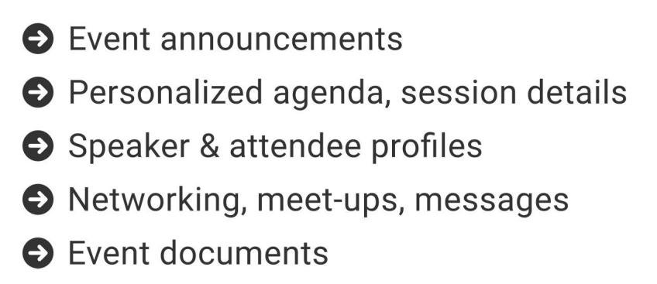
The official event app for the Microsoft Power Platform Conference – Fall 2023
Join the event app to access:
Event Invitation Code: PPCFall2023

Slide 3

Fold on tight – Understanding Power BI Query Folding in 20 minutes!
Nikola Ilic
@DataMozart

Slide 4




Nikola Ilic
Consultant & Trainer
data-mozart.com
@DataMozart
learn.data-mozart.com
I'm making music from the data!
Power BI and SQL addict, blogger, speaker...
Father of 2, Barca & Leo Messi fan...

Slide 5
Contents at Glance
Data Shaping & Power Query
Query folding
Devil is in the detail – Tips & Tricks
Where to go from here?
@DataMozart

Slide 6




Data Shaping
Perfect world – Data just comes into our reports “as-it-is”
Not exclusively related to Power BI
BEFORE it becomes part of your data model!
WHERE should you perform Data Shaping?
New York
NYC
New York City
@DataMozart

Slide 7

Power Query
More than 300 available transformations!
Transformation steps are saved
Mashup Engine + M language
@DataMozart

Slide 8
What is Query Folding?
Translate M to a query language
Pushing heavy lifting on the data source
Ability to generate a single SQL query that’s going to be executed on the data source side!
@DataMozart

Slide 9







Query Folding and Data Sources
Relational database engines
Odata, SSAS, Sharepoint lists, Exchange, AD…
Some sources don’t support folding at all!
@DataMozart

Slide 10

Query Folding and Data Transformations
Not all transformations will fold!
Subtle differences are sometimes decisive
Removing/renaming columns
Filtering rows
Grouping/Summarizing
Merging/Appending queries from the same source
Simple Custom columns
Pivot/Unpivot
Merging/Appending queries from different sources
Complex Custom columns
Index columns
Changing column data type (“it depends”)!
@DataMozart

Slide 11
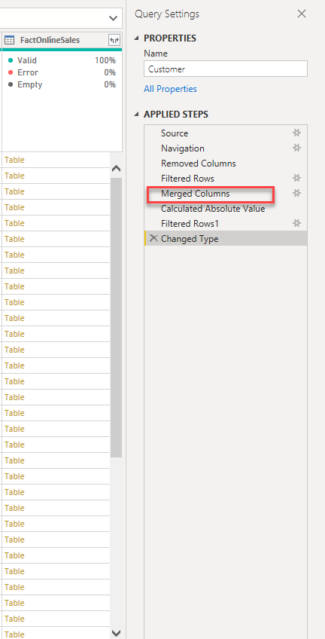
Query Folding – why should I care?
Data refresh more efficient
With DirectQuery/Dual the query must fold!
Incremental refresh
ALL or NOTHING?
Slow report
Slow visuals
Large data model
IT‘S NOT BECAUSE OF QUERY (NON)FOLDING!!!
@DataMozart

Slide 12
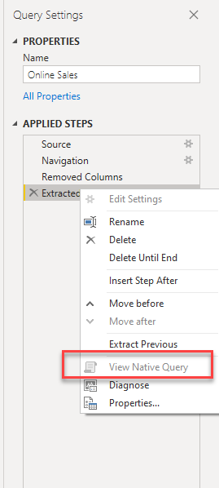
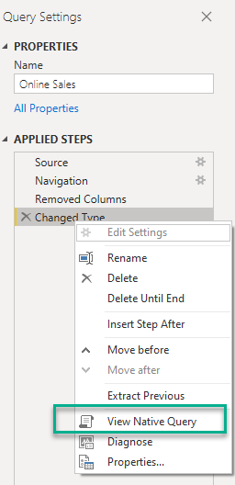
How do you know if the query folds?
View Native Query
It’s not 100% correct!!!
Use Query Diagnostics in PQ Editor or SQL Server Profiler
Icons in Power Query Online!
PROBABLY!!!
@DataMozart

Slide 13

Devil is in the details!
Little nuances can make a big difference!
DEMO TIME!
@DataMozart

Slide 14
Query folding – why should I care?
@DataMozart

Slide 15

Query folding
Power Query
Engine
Data
Data
Data already shaped and filtered!
@DataMozart

Slide 16
Query folding
Power Query
Engine
Data
Data
@DataMozart

Slide 17

Where to go from here?
30 days of Query folding challenge from Alex Powers
Chris Webb’s blog
Microsoft official documentation
@DataMozart

Slide 18
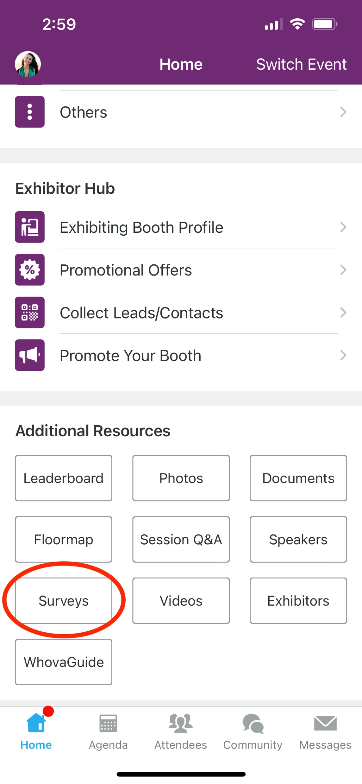
Session Feedback Surveys
We really want to hear from YOU!
In the pursuit of making next year’s Microsoft Power Platform Conference even better, we want to hear your feedback about this session.
Here’s How -
Simply go to the Whova App on your smartphone
Scroll down on the Microsoft Power Platform Conference Homepage to ‘Additional Resources’ to click “Surveys’.
Click Session Feedback.
Scroll down to find this session title.
Complete the session feedback survey.
Finally, click ‘Submit’
It’s just that easy!

Slide 19


Slide 20


Slide 21

Thank you!
data-mozart.com
@DataMozart
learn.data-mozart.com
@DataMozart

